Slide 1



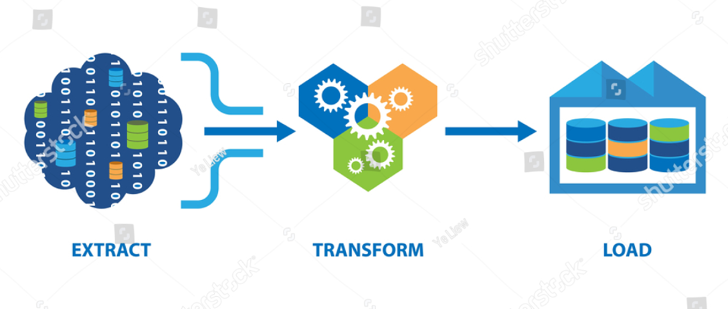
ETL Pipeline for House Data Analysis using Airflow
Group No:2
1. Atharva Sastikar(248514)
2. Yash Rathi(248556)
Guided By:
Dr Shantanu Pathak
Notes:
1

Slide 2
Problem Statement and Data Collection
Problem Statement
Dataset
The objective of this project is to design and implement an ETL (Extract, Transform, Load) pipeline for processing and analyzing house data.
Utilized Kaggle as a primary data source for real estate datasets.(~1M rows)
Link: https://www.kaggle.com/datasets/ahmedshahriarsakib/usa-real-estate-dataset
EDA:
No. of Rows: 1048576 Null values:
No. of Columns: 13
Notes:
2

Slide 3
Platform and Technologies
Apache Airflow :
Airflow is used as the workflow orchestration tool to manage the ETL pipeline.
2) Python :
Python is used for writing the logic for data extraction, transformation, and loading (ETL).
3) Pandas :
Pandas is used for reading, transforming, and cleaning the dataset (CSV in this case)
4) AWS S3 :
Amazon S3 is used to store the transformed data.
5) AWS Quicksight :
AWS Quicksight is used to visualize the transformed data from S3.
6) AWS Hooks :
S3 Hooks are used to facilitate relation between Airflow and S3.
Notes:
2

Slide 4
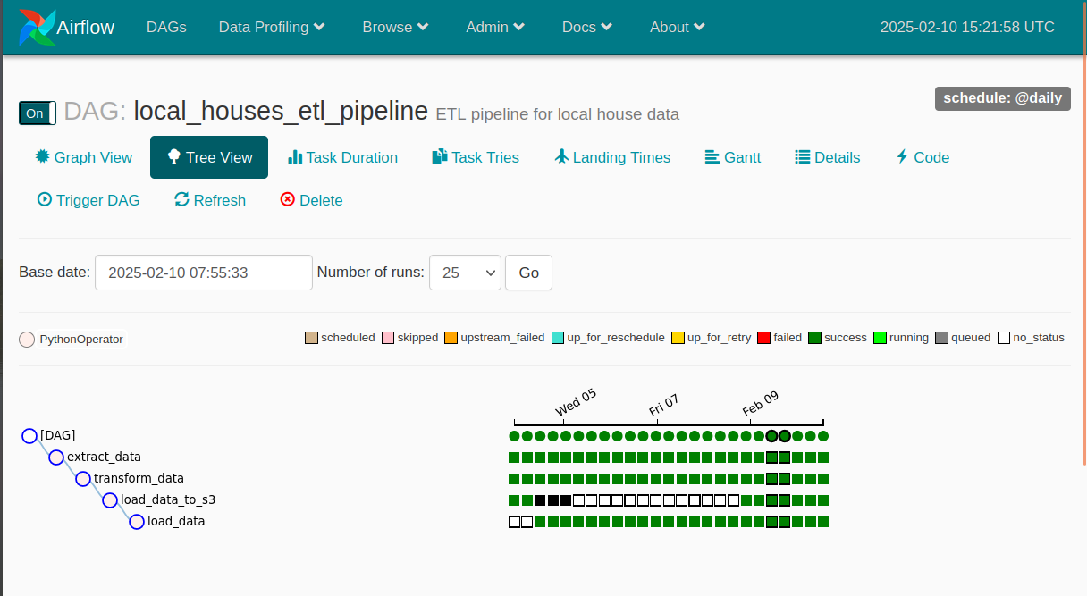




Airflow Pipeline Setup
ETL Orchestration
Utilized Apache Airflow. Designed for building, scheduling and managing the ETL pipeline.
DAG Development
Developed DAGs (Directed Acyclic Graphs). Defined tasks for Extract, Transform, and Load processes.
Code Implementation
Wrote code for each stage. Ensures proper data handling and processing.
Notes:
3

Slide 5

Data Transformation Steps
Null Value Handling
Data Cleaning
Checked and removed null values. Used a threshold of 5% for certain columns.
Removed duplicate rows. Removed unwanted characters from columns.
Date Formatting
Standardized date columns. Converted to YY-MM-DD format.
Notes:
4

Slide 6

More Data Transformations
1
Price Cleaning
2
Column Name Standardization
Removed symbols from price columns.
Converted column names to lowercase. Eliminated case sensitivity.
3
Feature Engineering
Added "Holding period" and "price_per_sqft" columns. For analysis.
Notes:
5

Slide 7




Airflow and AWS Integration
Libraries
Airflow
AWS S3
Imported and upgraded Libraries to connect with AWS.
Loaded transformed data into S3.
Connected Airflow to AWS.
Notes:
6

Slide 8
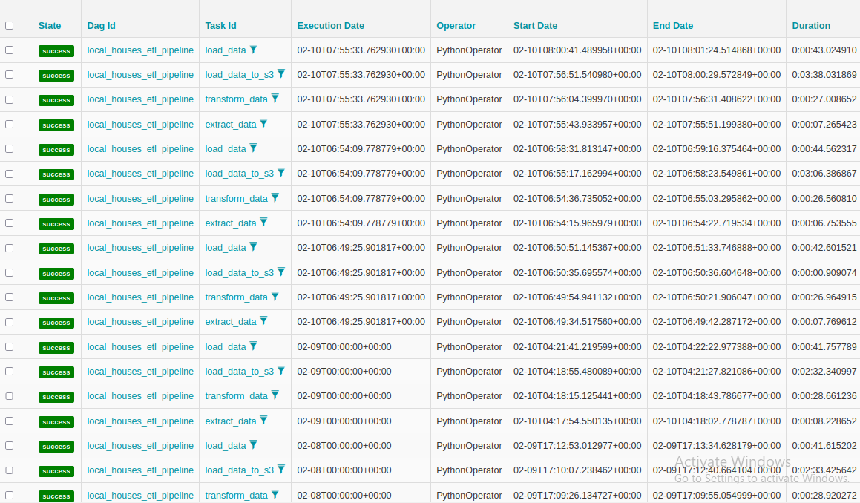
Pipeline Monitoring
1
Airflow Webserver
Monitored pipeline status.
Checked logs for errors.
2
Version Control
Ensured required Airflow versions.
Upgraded Airflow as needed.
Notes:
7

Slide 9
Data Analysis with Quicksight
AWS Quicksight
Manifest File
Utilized AWS Quicksight BI Tool. Analyzed the transformed data.
Connected Quicksight with S3 using a manifest file.
Notes:
8

Slide 10

Key Takeaways and Next Steps
1
Successful ETL Pipeline
2
Data Transformation
3
AWS Integration
Loaded data to S3 and analyzed it using AWS Quicksight.
Implemented an ETL pipeline using Airflow.
Transformed data for analysis.
Notes:
9

